Slide 1



Day 26
contact@anubhavtrainings.com
ABAP RESTFUL APPLICATION PROGRAMMING

Slide 2

Agenda – Day 26
Creating OData Service ( Business Service)
Introduction to Fiori Elements
Free style v/s Fiori Elements App
Developer persona – Fiori Elements
List Report Object Page App
Developing Read-Only List Reporting Apps
UI Annotation
Adding Search Capabilities
Adding Metadata Extension
Local Types/Classes in ABAP with Global Classes
Implementing Class Pool Concept

Slide 3
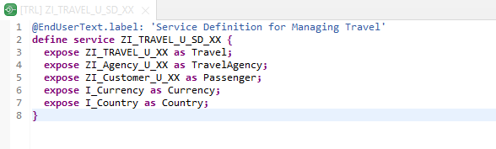
Create OData Service ( Business Service )
Create OData Service ( Business Service )
A business service definition (short form: service definition) describes which CDS entities of a data model are to be exposed so that a specific business service, for example, Sales Order handling, can be enabled. It is an ABAP Repository object that describes the consumer-specific but protocol-agnostic perspective on a data model. “ZI_TRAVEL_U_SD_XX”
CDS Entity
Service Definition
Service Binding

Slide 4
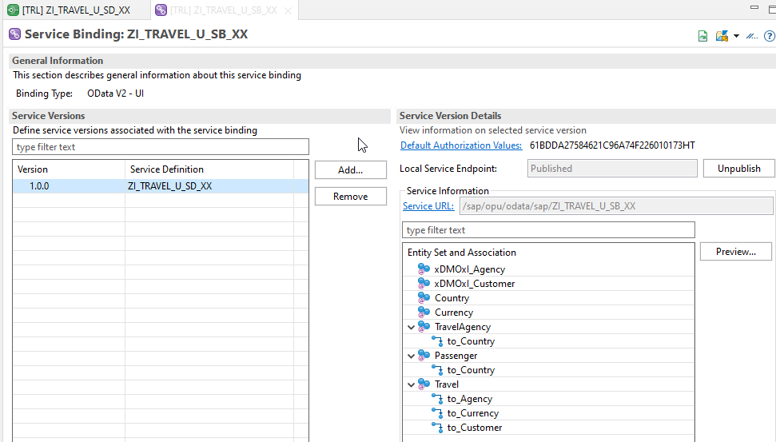
Service Binding ( Business Service )
Service Binding ( Business Service )
The business service binding (short form: service binding) is an ABAP Repository object used to bind a service definition to a client-server communication protocol such as OData. Like any other repository object, the service binding uses the proven infrastructure of the ABAP Workbench, including the transport functionality

Slide 5

Introduction to SAP Fiori Elements
SAP Fiori elements provides standard floorplans and uses metadata to streamline and accelerate developing SAPUI5 applications.
SAP Fiori elements
▪ Delivers enterprise-ready SAPUI5 apps based on
stable, optimized, out-of-the-box UI code
▪ Boosts developer efficiency by scaling development
and maintenance in a cost-efficient way
▪ Provides a centrally managed, consistent UX
complying with the latest SAP Fiori design
▪ Ensures upgrade stability and forward compatibility
▪ Allows extensibility of standard floorplans with custom
controls and logic
www.anubhavtrainings.com

Slide 6
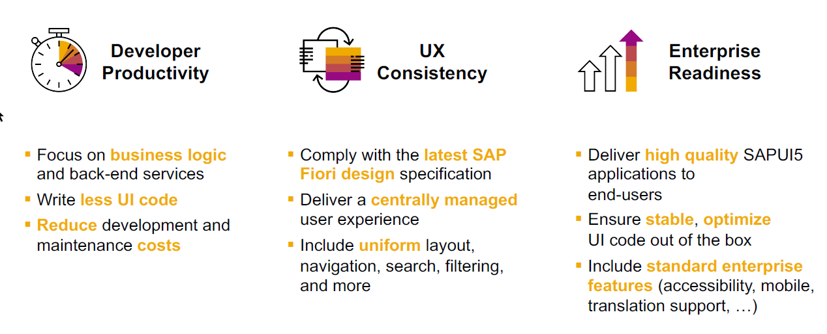
SAP Fiori elements boosts SAP Fiori development efficiency
www.anubhavtrainings.com

Slide 7

SAP Fiori elements prioritizes efficiency over flexibility
www.anubhavtrainings.com

Slide 8


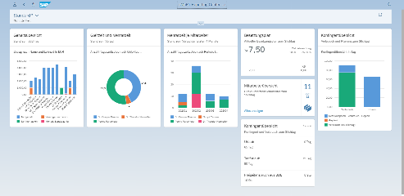





Developer Persona – Fiori Elements
Anubhav
Happy User
Rob
S/4HANA Technical consultant
ABAP Developer
Roxana
UX Designer | Fiori Developer
ABAP Dev. Tools
On
Eclipse
VS Code
BAS
OData Service
Fiori Elements Project
Annotations.xml
CDS Views
MDE
@
www.anubhavtrainings.com

Slide 9
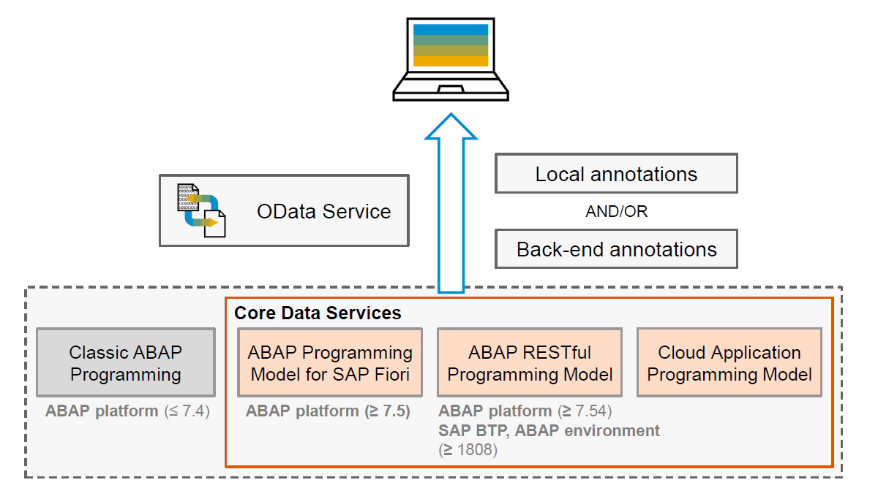
Big Picture – Architecture
www.anubhavtrainings.com

Slide 10
Fiori Elements - List Report Application
The list report offers powerful features for finding and acting on relevant data sets. It is often used as an entry point for navigating to the item details, which are usually shown on an object page.
List Report
Object Page
www.anubhavtrainings.com

Slide 11
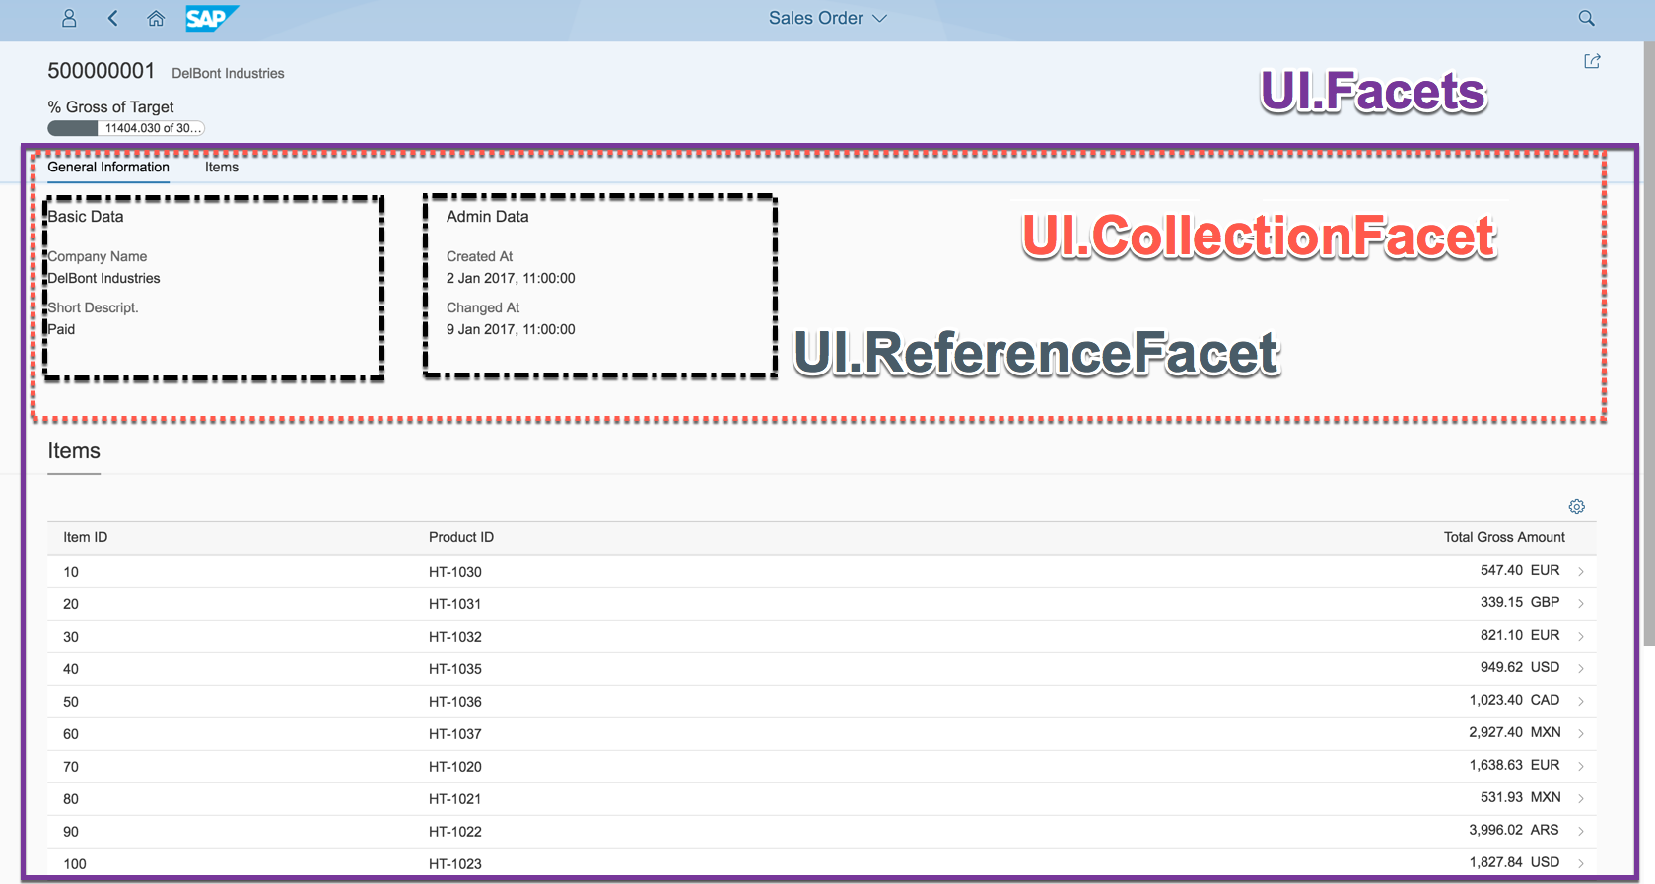
Object Page
www.anubhavtrainings.com

Slide 12
Developing Read only List Report
UI Annotations
@UI.selectionField – Bring a filter field on smart filter bar
@UI.lineItem – enable us to put a column inside the smart table, position, label
@UI.identification – used create fields in Object page
@Semantics.amount.currencyCode – mark the unit of amount field
@UI.headerInfo.typeName – Label for displaying single record
@UI.headerInfo.typeNamePlural – Table Label
@UI.facet: [{purpose : #STANDARD – This will create a section inside the object page
type: #IDENTIFICTION_REFERENCE – What type of data you want to display}]
Documentation
Documentation Link for ABAP RAP

Slide 13
Features with use of Annotation
Simple Report with Selection Fields and Columns
2. Facet with section containing fields of drill-down
Change Labels of Column and Fields
Adding Text for given Customer
Support for Value help
Search Field with Default search element (Hana fuzzy search)

Slide 14
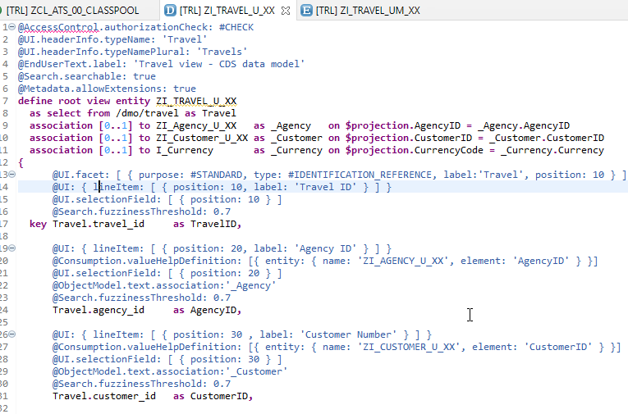
CDS Views with Annotations
Exercise
ZI_AGENCY_U_XX ( Agency )
ZI_Customer_U_XX ( Customer )
ZI_TRAVEL_U_XX ( Travel )

Slide 15
Local Types/Classes in ABAP with Global Classes
Local Types for Global Classes - Within class pools, as in virtually any other ABAP program, data types, local interfaces, and local classes can be defined to ensure a better structure of the implementation of the global class.
More number of classes will cause confusion and over-modularization increase the complexity of our design
More number of global classes, will increase the chance of our code being exposed to reports/classes which we may want to use only a private
Allow a modularized way of designing app but still keeping our code in a single contain, a good balance between number of classes v.s modularization.
At times we need so many classes for different purpose with very limited no of methods. 2 meh. + 20 classes, Create a class pool would be a good options.

Slide 16
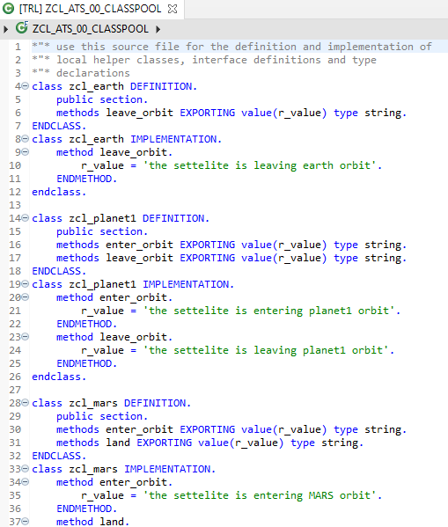
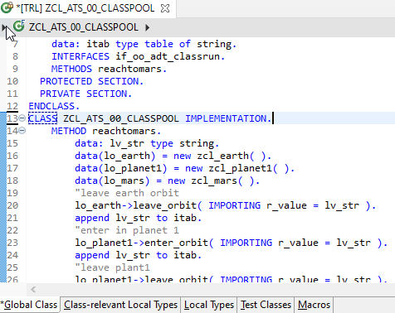
Implementing Class Pool Concept
Global Class
Exercise
Class Pool Code
Local Types/Class

Slide 17

End of Day 26
Trainer: Anubhav Oberoy

Slide 18
Trainer: Anubhav Oberoy

Slide 19
THANK YOU
If you cannot do
great things, do small things in a great way.
Anubhav Oberoy
https://www.anubhavtrainings.com

Slide 20


We’re committed to empower you to be
Most Desirable Resource
through powerful training solutions.
We build the workforce of the future.
250+
Corporate Clients
30,000+
Learners Trained
25000+
Learners Placed
FREE WEBINARS
Sign up for free webinars with industry experts every fortnight!
Enroll Now!
Contact us today!
https://anubhavtrainings.com/

Slide 21




More from AnubhavTrainings.com

Slide 22
Behavior Definition
A Business Object BDEF is an ABAP Repository object (just like Tables, classes, FM, Programs).
This BDEF determines the behavior of an BO in context of RESTful ABAP programming. In simple words, what are all the different operations our BO can do like create, update, delete..
This is created using BDL (Behavior definition Language)) and comprises modeling capability aspect of BP node for e.g. CRUD, actions, local between parent child etc.
A BDEF always refers to a CDS Model. This reference results from the name equality with root entity,
Your CDS view name = BDEF Name
CDS View (root)
Business Object
Behavior Definition
Code is written in behavior pool, pool of local classes inside a global class
1 0..1
1
1
1..N
0..N
CDS Childs
Behavior Implementation
(M- option, U- Mandatory)

Slide 23
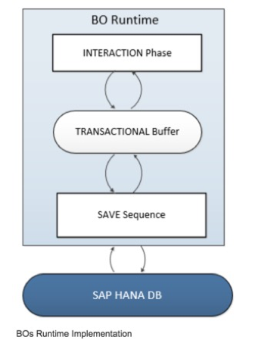
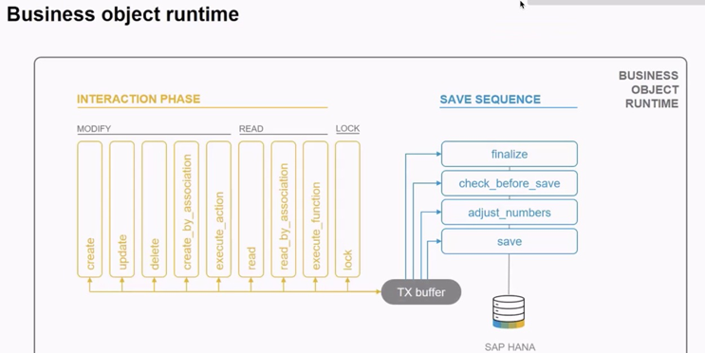
Business Object’s Runtime Implementation
The business object runtime mainly consists of two parts: The first part is the interaction phase where a consumer calls the business object operations to change data and read instances with or without the transactional changes. The business object runtime keeps the changes in its internal transactional buffer which represents the state of the instance data. This transactional buffer is always required for a business object. After all changes were performed, the data can be persisted. This is realized with the save sequence.

Slide 24
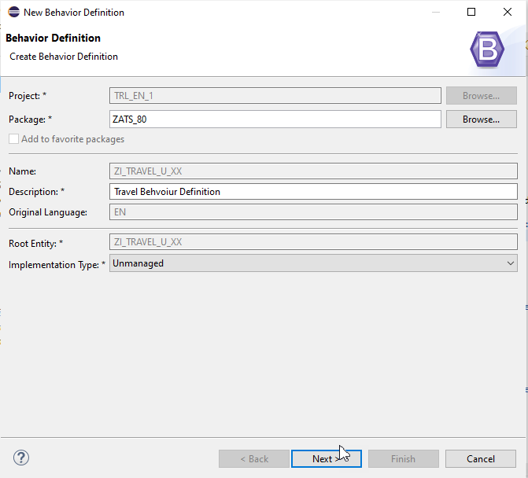
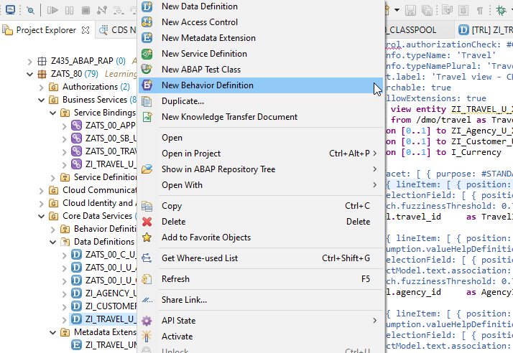
Implementing of Behaviour Definition

Slide 25
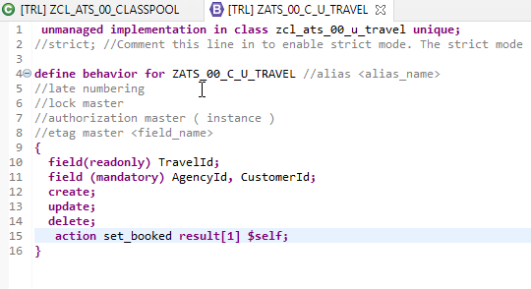
Exercise
Behaviour Definition

